Slide 1
JJAX AN NFT Based Music Sharing Platform
Group 12 – Andrew McWilliam, Jake Grieves, Jaiyi Zhong and Xinrui Hue

Slide 2

Intro
Topic one
Topic two
Topic three
Topic four

Slide 3

Introduction
With PowerPoint, you can create presentations and share your work with others, wherever they are. Type the text you want here to get started. You can also add images, art, and videos on this template. Save to OneDrive and access your presentations from your computer, tablet, or phone.

Slide 4
Market Research

Slide 5
Our Idea

Slide 6
Demo
Embed a video?

Slide 7

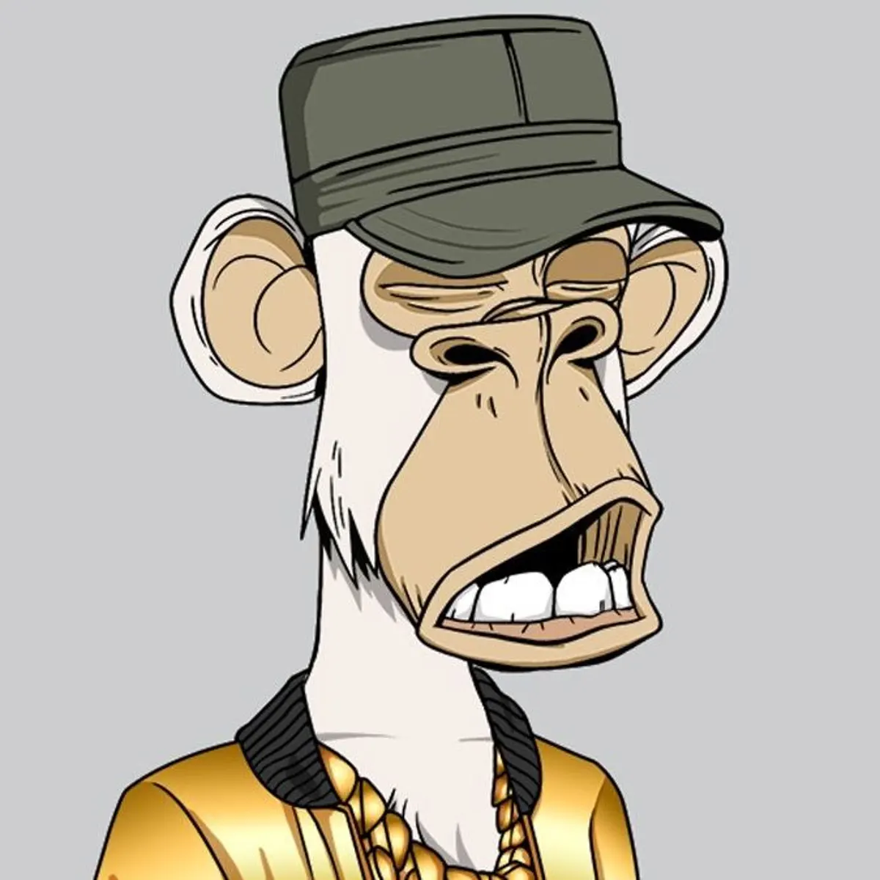

Background Technology
The project is heavily based on the ERC 721 “Non-Fungible Token Standard”
OpenZeppelins’ implementation is used by the project through inheritance.
IPFS is used to host the song metadata

Slide 8
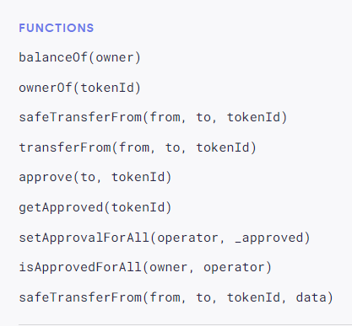
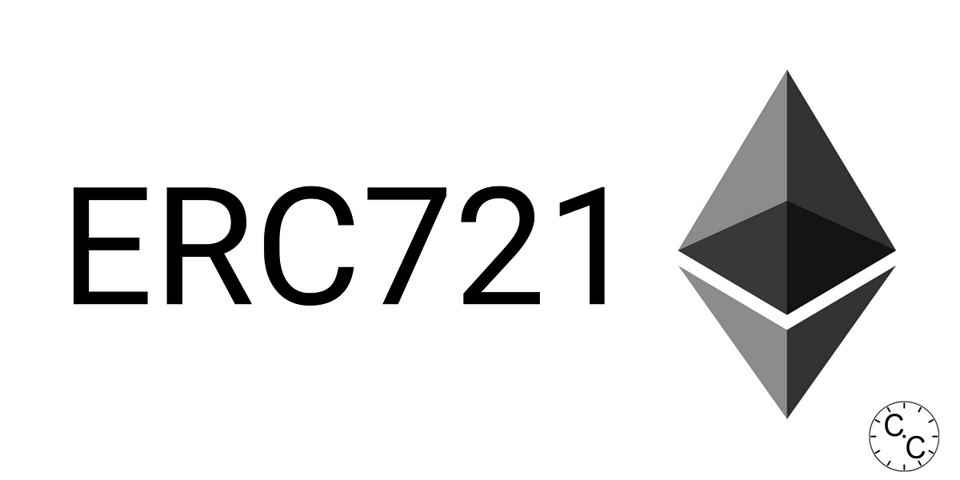
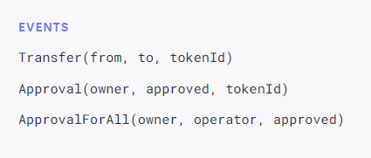
The “Non-Fungible Token Standard”
Inspired by the ERC 20 standard
provides basic functionality to track and transfer NFTs.
Shown are the requirements for an object to be ERC 721 Complacent

Slide 9
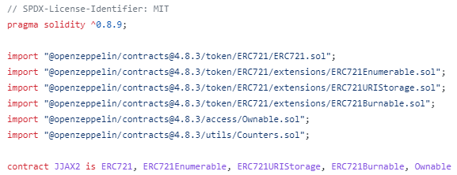
OpenZeppelin is an open-source framework and library for building secure and audited smart contracts on the Ethereum blockchain.
Contains an implementation of the ERC 721 standard (and extensions), which are used by the project.
The project makes use of five base contracts for added functionality.
ERC721.sol
Ownable.sol
Counters.sol
Enumerable.sol
URIStorage.sol
Burnable.sol

Slide 10


IPFS
“A peer-to-peer hypermedia protocol designed to preserve and grow humanity's knowledge by making the web upgradeable, resilient, and more open.”
Decentralised File Sharing Platform Perfect for our needs in the project.
Each piece of content is identified by a unique hash.
Third party applications are used to upload and view data.

Slide 11
Backend Design

Slide 12
Front End

Slide 13



Future Scope
Deployment to the Ethereum Mainnet
ERC 1150 Token Standard
OpenSea integration

Slide 14




Thank you
Presenter name
Email address
Website

